Slide 1
C# & .NET Framework
Chapter 24:
ASP.NET 2.0 Web Applications

Slide 2
Review
HTTP: a protocol for transferring HTML document
HTML: a markup language
Client-Side Scripting: JavaScript, VBScript
GET and POST method
ASP.NET Web Page Code Model: Single and Code-Behind
HTTP Request + HTTP Response
Building a Simple ASP.NET 2.0 Website: Master page, Menu, GridView, Wizard
Validation Controls: RequiredFieldValidator, RegularExpressionValidator, RangeValidator, CompareValidator

Slide 3
Chapter 24: Objectives
The Issue of State
ASP.NET State Management Techniques
Understanding the Role of ASP.NET View State
The Role of the Global.asax File
Understanding the Application/Session Distinction
Working with the Application Cache
Maintaining Session Data
Understanding Cookies
Configuring Your ASP.NET Web Application Using Web.config
Configuration Inheritance

Slide 4
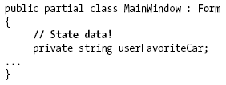
The Issue of State
When building a Windows Forms application, any member variables defined in the Form-derived class will typically exist in memory until the user explicitly shuts down the executable:

Slide 5
The Issue of State
HTTP has no clue how to automatically remember data once the HTTP response has been sent, it stands to reason that the Page object is destroyed instantly. Therefore, when the client posts back to the *.aspx file, a new Page object is constructed that will reset any page-level member variables.
It is the same to Java servlets, CGI applications, classic ASP, and PHP.

Slide 6
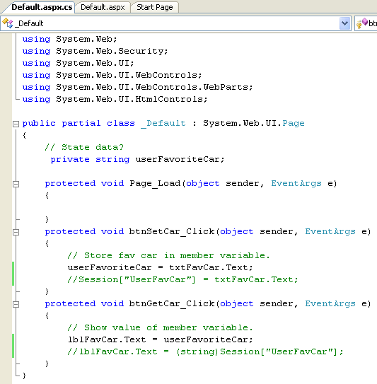
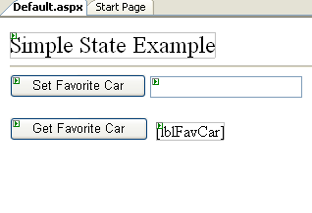
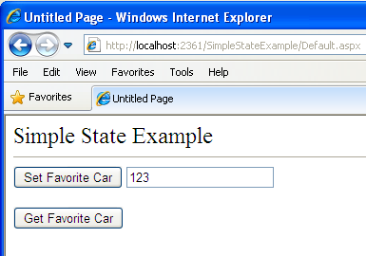
Example: SimpleStateExample
No value displayed here

Slide 7
ASP.NET State Management Techniques
ASP.NET provides several mechanisms to maintain stateful information in your web applications:
Make use of ASP.NET view state.
Define application-level variables.
Make use of the cache object.
Define session-level variables.
Interact with cookie data.

Slide 8
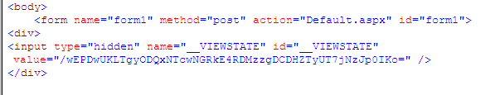
Understanding the Role of ASP.NET View State
ASP.NET runtime will automatically embed a hidden form field (named __VIEWSTATE), which will flow between the browser and a specific page.
The data assigned to this field is a Base64-encoded string that contains a set of name/value pairs that represent the values of each GUI widget on the page at hand.
Init event handler is the entity in charge of reading the incoming values found within the __VIEWSTATE field to populate the appropriate member variables in the derived class.

Slide 9
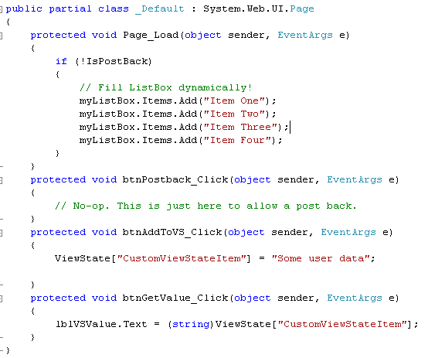
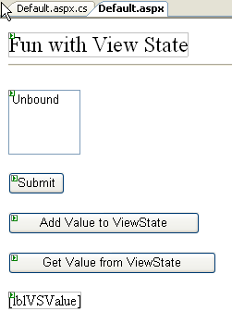

ViewState Example (Ch_24 code\ViewStateApp)
Display value of ViewState

Slide 10
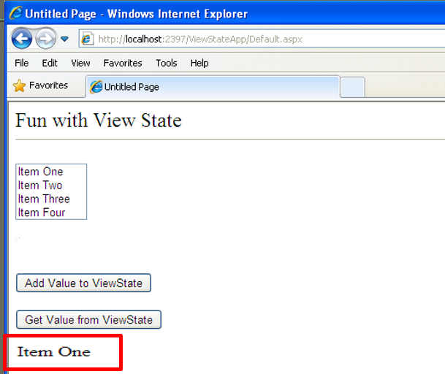
ViewState Example (Ch_24 code\ViewStateApp)

Slide 11
The Role of the Global.asax File
Each ASP.NET web application has one Global.asax file that contains some functions that can be invoke during that application life cycle
Event Handler | Description
Application_Start() | This event handler is called the very first time the web application is launched
Application_End() | This event handler is called when the application is shutting down
Session_Start() | This event handler is fired when a new user logs on to your application. Here you may establish any user-specific data points.
Session_End() | This event handler is fired when a user’s session has terminated (typically through a predefined timeout).
Application_Error() | This is a global error handler that will be called when an unhandled exception is thrown by the web application.

Slide 12
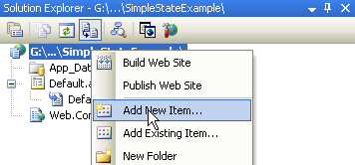
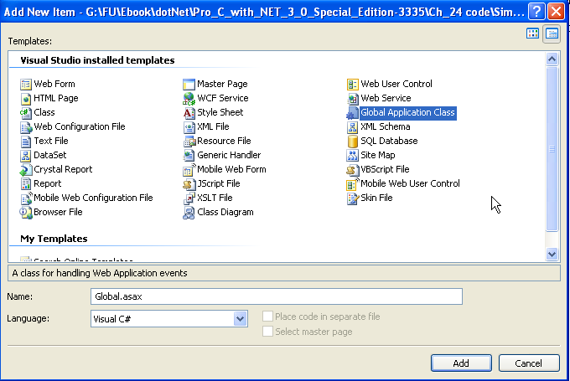
Create Global.asax file
Do not change the name

Slide 13
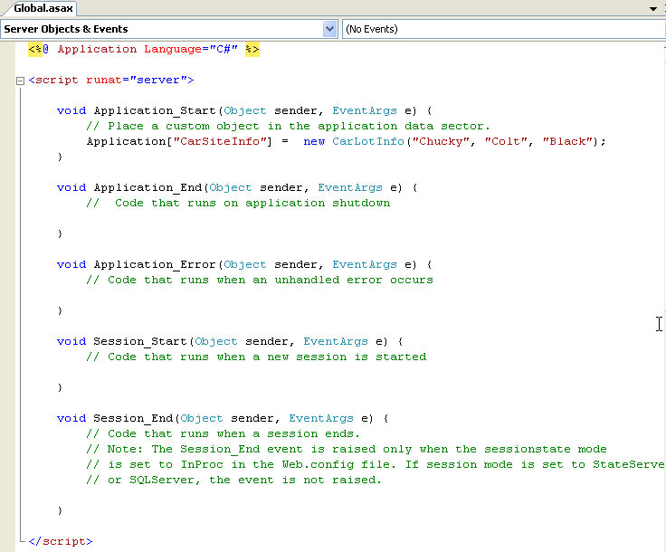
Create Global.asax file

Slide 14
The HttpApplication Base Class
The Global.asax script is dynamically generated into a class deriving from the System.Web.HttpApplication base class, which supplies the same sort of functionality as the System.Web.UI.Page type
Property | Description
Application | This property allows you to interact with application-level variables, using the exposed HttpApplicationState type.
Request | This property allows you to interact with the incoming HTTP request (via HttpRequest).
Response | This property allows you to interact with the incoming HTTP response (via HttpResponse).
Server | This property gets the intrinsic server object for the current request (via HttpServerUtility).
Session | This property allows you to interact with session-level variables, using the exposed HttpSessionState type.
Key Members Defined by the System.Web.HttpApplication Type

Slide 15
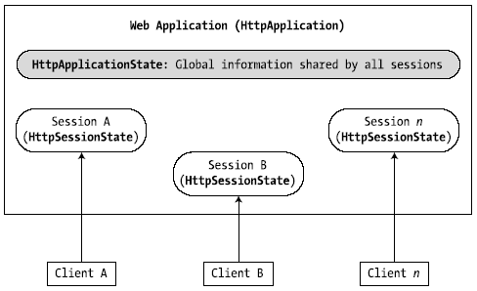
Application/Session Distinction
Application state is maintained by an instance of the HttpApplicationState type.
This class enables to share global information across all users (and all pages) who are logged on to your ASP.NET application.
Session state is maintained by HttpSessionState class type
used to remember information for a specific user
When a new user logs on to an ASP.NET web application, the runtime will automatically assign that user a new session ID.

Slide 16
Maintaining Application-Level State Data
The HttpApplicationState type enables developers to share global information across multiple sessions in an ASP.NET application.
Members | Description
AllKeys | This property returns an array of System.String types that represent all the names in the HttpApplicationState type.
Count | gets the number of item objects in the HttpApplicationState type.
Add() | add a new name/value pair into the HttpApplicationState type.
Clear() | deletes all items in the HttpApplicationState type. This is functionally equivalent to the RemoveAll()method.
Lock(), Unlock() | alter a set of application variables in a thread-safe manner.
RemoveAll(), Remove(), RemoveAt() | remove a specific item (by string name) within the HttpApplicationState type. RemoveAt() removes the item via a numerical RemoveAt() indexer.

Slide 17
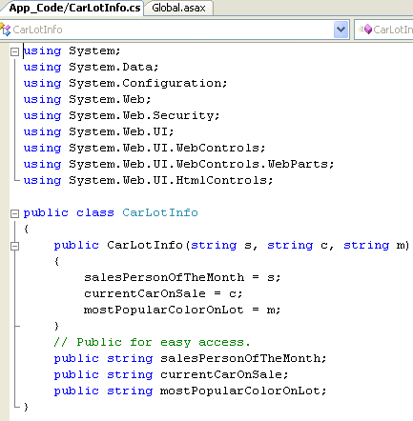
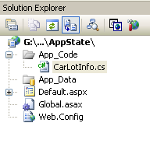
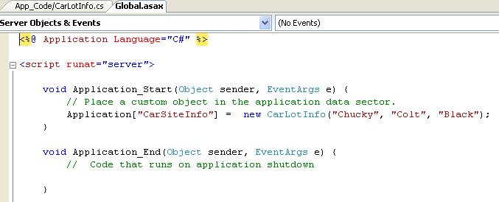
Application State Demo (Ch_24 code\AppState)

Slide 18
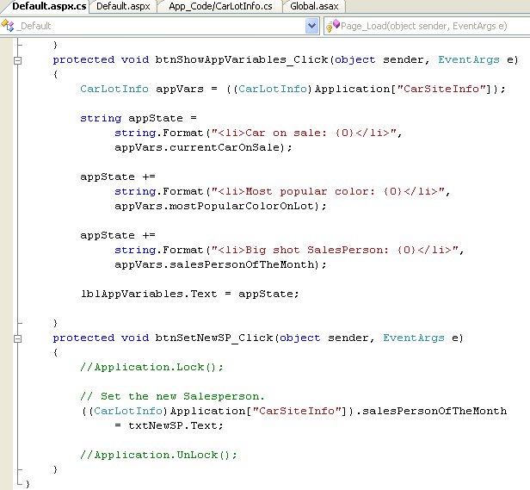
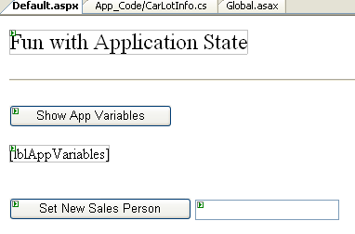
Application State Demo (Ch_24 code\AppState)

Slide 19
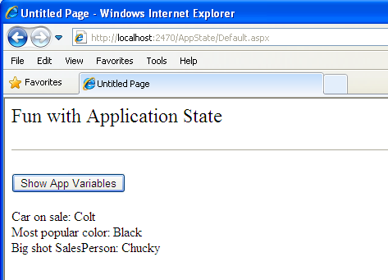
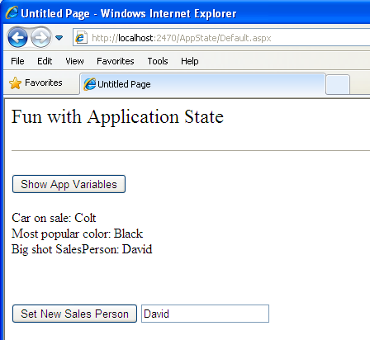
Application State Demo (Ch_24 code\AppState)

Slide 20
Working with the Application Cache
The ASP.NET System.Web.Caching.Cache object (which is accessible via the Context.Cache property) allows you to define an object that is accessible by all users (from all pages) for a fixed amount of time.
Example: CacheState

Slide 21
Maintaining Session Data
When a new user logs on to your web application, the .NET runtime will automatically assign the user a unique session ID
Each session ID is assigned a custom instance of the HttpSessionState type to hold on to user-specific data.

Slide 22
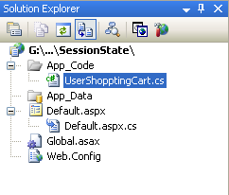
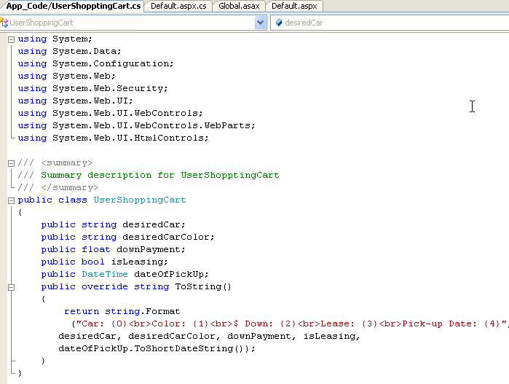
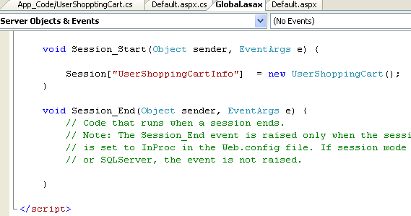
Session Data Example (Ch_24 code\SessionState)
UserShoppingCard.cs
Global.asax
Notes:
Use the Abandon method to end a session immediately: Session.Abandon

Slide 23
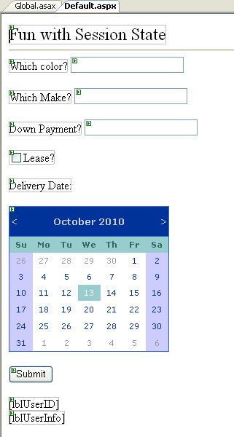
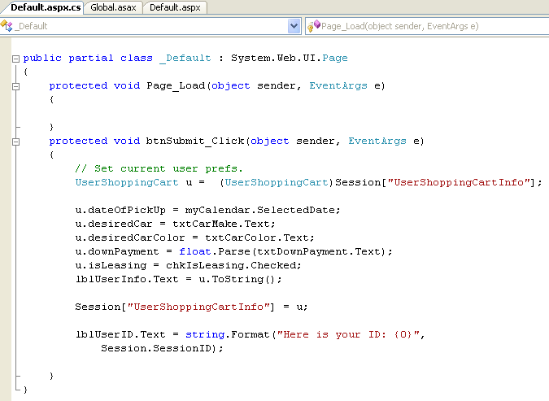
Session Data Example (Ch_24 code\SessionState)

Slide 24
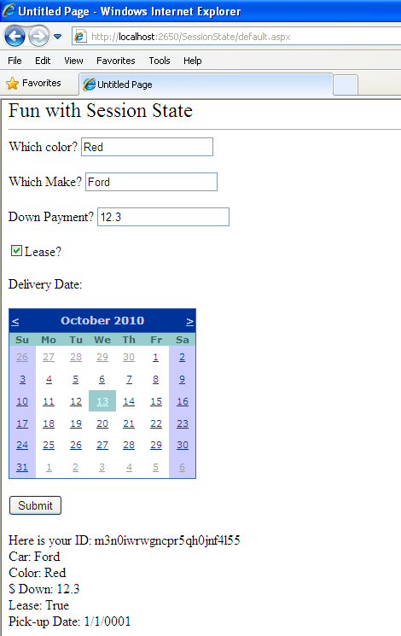
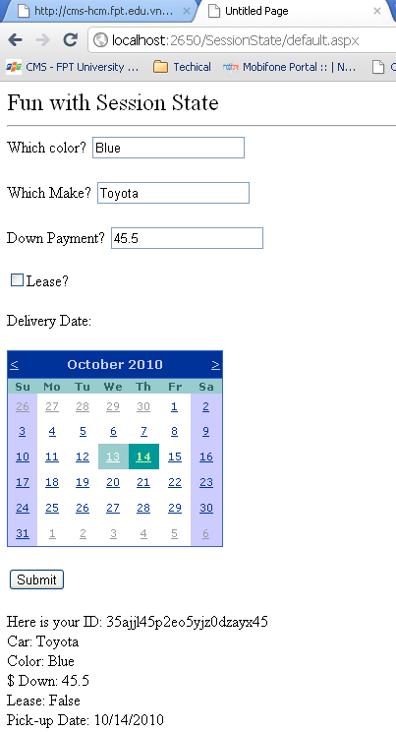
IE browser
Chrome browser

Slide 25



Labs

Slide 26
Understanding Cookies
Cookie is a text file (or set of files) on the user’s machine.
When a user logs on to a given site, the browser checks to see if the user’s machine has a cookie file for the URL in question and, if so, appends this data to the HTTP request.
The receiving server-side web page could then read the cookie data to create a GUI that may be based on the current user preferences.
Cookies are stored by default under C:\Documents and Settings\<loggedOnUser>\Cookies.
Cookies are a horrible choice when you wish to maintain sensitive information about the current user (such as a credit card number, password, or whatnot).

Slide 27
Understanding Cookies
Creating Cookies
ASP.NET cookies can be configured to be either persistent or temporary:
A persistent cookie is typically regarded as the classic definition of cookie data, in that the set of name/value pairs is physically saved to the user’s hard drive.
Temporary cookies (also termed session cookies) contain the same data as a persistent cookie, but the name/value pairs are never saved to the user’s machine; rather, they exist only within the HTTP header. Once the user logs off your site, all data contained within the session cookie is destroyed.
Note: Most browsers support cookies of up to 4,096 bytes => cookies are
best used to store small amounts of data, such as a user ID that can be
used to identify the user and pull details from a database.

Slide 28
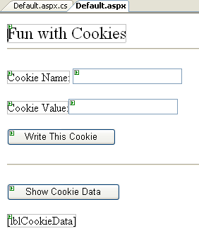
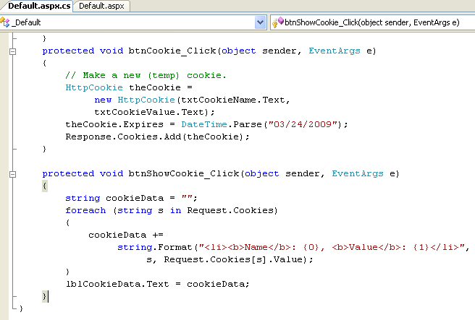

Cookie Demo (Ch_24 code\CookieStateApp)

Slide 29
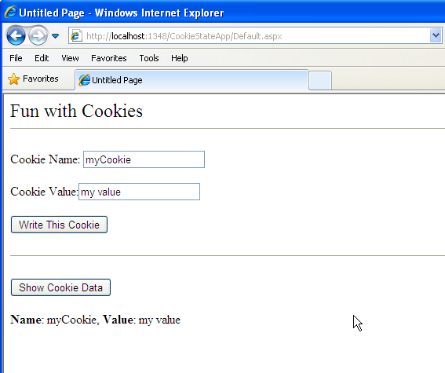
Cookie Demo (Ch_24 code\CookieStateApp)

Slide 30
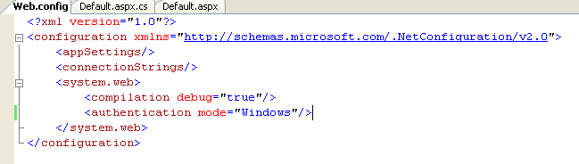
Configuring ASP.NET Web Application Using Web.config
In ASP .NET, the web-centric configuration files are always named Web.config, with default structure:

Slide 31
Configuring ASP.NET Web Application
Element | Description
<appSettings> | establish custom name/value pairs that can be programmatically read in memory for use by your pages
<authentication> | used to define the authentication mode for this web application.
<authorization> | used to define which users can access which resources on the web server.
<compilation> | used to enable (or disable) debugging
<connectionStrings> | used to hold external connection strings
<customErrors> | used to tell the runtime exactly how to display errors
<globalization> | used to configure the globalization settings
<sessionState> | used to control how and where session state data will be stored by the .NET runtime.
<trace> | This element is used to enable (or disable) tracing support for this web application.

Slide 32
Enabling Tracing via <trace>
<trace enabled = "true|false"
localOnly = "true|false"
pageOutput = "true|false"
requestLimit = "integer"
traceMode = "SortByTime|SortByCategory"/>
localOnly: Indicates that the trace information is viewable only on the host web server and not by remote clients (the default is true).
requestLimit: Specifies the number of trace requests to store on the server. The default is 10
To view trace information, using:
http://localhost/MyWebApplication/trace.axd

Slide 33
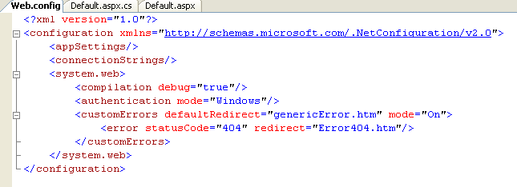
Customizing Error Output via <customErrors>
<customErrors defaultRedirect = "url" mode="On|Off|RemoteOnly">
<error statusCode="statuscode" redirect="url"/>
</customErrors>
Example

Slide 34
List of Common HTML Error Codes
Code | Description | Comment
400 | Bad Request | The request had bad syntax or was impossible to be satisified.
401 | Unauthorized | User failed to provide a valid user name / password required for access to file / directory.
402 | Payment Required
403 | Forbidden | The request does not specify the file name. Or the directory or the file does not have the permission that allows the pages to be viewed from the web.
404 | Not Found | The requested file was not found.
405 | Method Not Allowed
406 | Not Acceptable
407 | Proxy Authentication Required

Slide 35
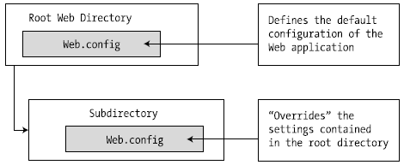
Configuration Inheritance
The machine.config file is the ultimate parent in
the configuration inheritance hierarchy.

Slide 36
Summary
HTTP issue: Stateless
ASP.NET provides several mechanisms to maintain stateful information in your web applications:
Make use of ASP.NET view state.
Make use of ASP.NET control state.
Define application-level variables.
Make use of the cache object.
Define session-level variables.
Interact with cookie data.
Configuring web site through web.config

Slide 37



Chapter 24: Q & A
Dowload and Run Database_Northwind_for_Lab_CachDependency.sql
to create Northwind database , this database included a table named Products

